Slide 1


Predictive analysis of higher education student performance
By Namrata Dutta

Slide 2

Project Overview
Aim: To analyze and understand factors influencing student enrollment, academic performance, and socio-economic background in higher education institutions.
Goal: Identify patterns, trends, and potential areas for intervention or improvement.
Outcome: Develop predictive models to forecast enrollment patterns, student success rates, and the impact of economic indicators on the education sector.
Importance: Provide valuable insights for educational policymakers, administrators, and stakeholders to enhance educational access, equity, and quality.

Slide 3
PROJECT DESCRIPTION
Data Understanding and Preparation:
Loaded and inspected the dataset.
Handled missing values and decoded encoded categorical variables.
Ensured data was clean and properly formatted.
Exploratory Data Analysis (EDA):
Generated descriptive statistics.
Visualized the distribution of numerical and categorical variables.
Created correlation matrices and heatmaps to understand relationships between variables.
Feature Engineering:
Selected relevant features based on domain knowledge and correlation analysis.
Created new features if necessary to improve model performance.
Model Training and Evaluation:
Split the data into training and testing sets.
Trained multiple predictive models (e.g., linear regression, decision trees, random forests).
Evaluated model performance using metrics like Mean Squared Error (MSE), R-squared (R²), accuracy, precision, and recall.
Interpretation and Visualization:
Interpreted model coefficients or feature importances.
Visualized actual vs. predicted values and feature importances.
Diagnosed model fit using residual plots.
Reporting and Conclusion:
Summarized findings and provided actionable recommendations.
Highlighted key insights and suggested areas for further investigation or intervention.

Slide 4

Analysis of Factors Influencing Higher Education Student Performance

Slide 5
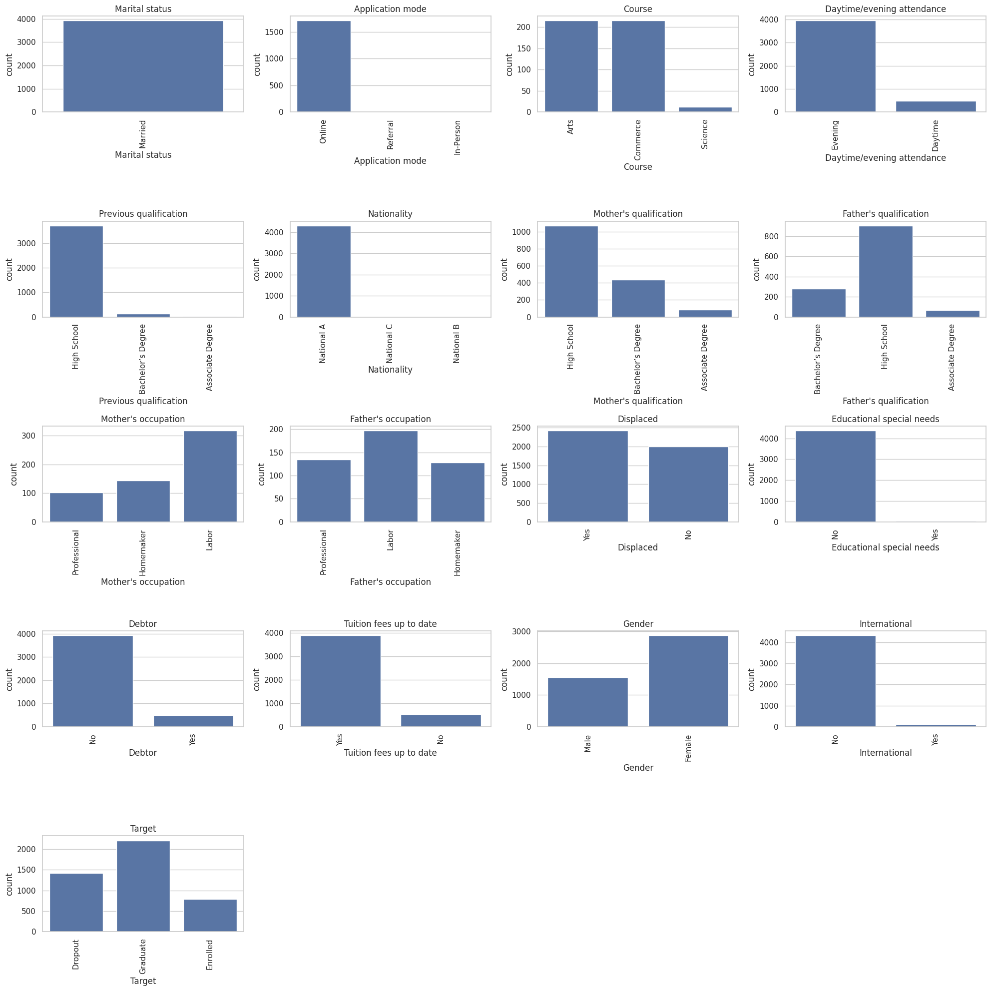

Slide 6
Conclusion from the analysis
Marital Status:
Majority of students are single.
Young, unmarried population may affect study habits.
Application Mode:
Most students apply online.
Preference for online applications indicates convenience and accessibility.
Course:
Highest enrollment in Arts courses.
Reflects popularity or institutional strengths.
Daytime/Evening Attendance:
Majority attend daytime classes.
Aligns with traditional academic schedules.
Previous Qualification:
Most students have high school qualifications.
Indicates direct transition from high school to higher education.
Nationality:
Majority from National A.
Reflects demographic reach and need for tailored services.
Mother’s Qualification:
Most mothers have high school qualifications.
Influences academic support at home.

Slide 7
Father’s Occupation:
Most common occupation is labor.
Influences financial stability and support.
Displaced Status:
Even split between displaced and non-displaced students.
Highlights need for specific support services.
Educational Special Needs:
Majority do not have special needs, but a notable minority does.
Ensures adequate resources for inclusive education.
Debtor Status:
Most students are not debtors.
Financial stability is common, but some face challenges requiring aid.
Tuition Fees Up to Date:
Most students have up-to-date tuition fees.
Crucial for academic progress.
Gender:
More male students than female students.
May need gender equity initiatives.
International Status:
Majority are domestic students.
Potential to increase international enrollment.
Performance Outcome (Target):
Most students are enrolled, followed by graduates and dropouts.
High retention and graduation rates; focus on reducing dropout rates.

Slide 8
Scatter plot analysis and Correlation Matrix analysis

Slide 9
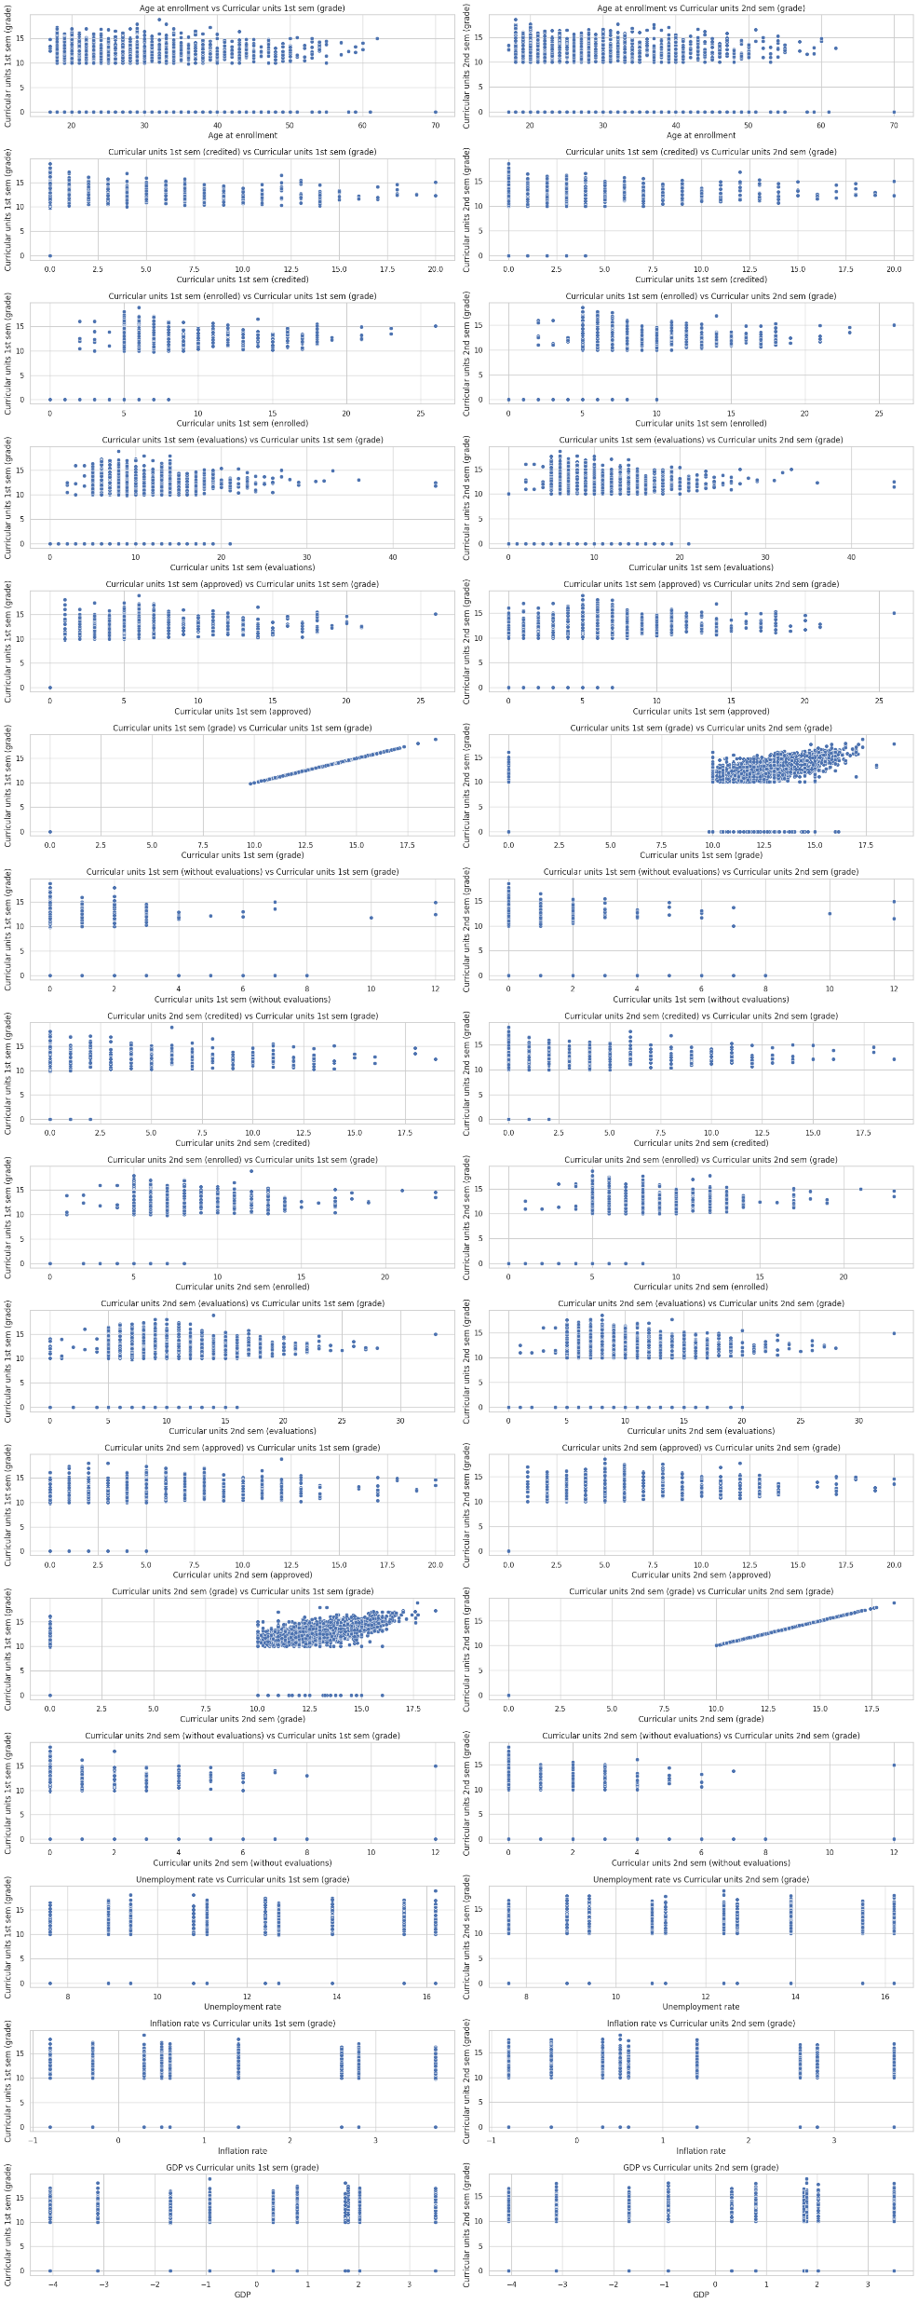

Slide 10
SCATTER PLOT ANALYSIS
Description:
This analysis examines the relationships between students' academic performance and various academic metrics (credited, enrolled, evaluated, approved units) for both the first and second semesters.
It also explores the impact of economic indicators (unemployment rate, inflation rate, GDP) on academic performance.

Slide 11
Key insights of Scatter plot
Age at Enrollment vs. Grades:
There is no significant trend between age at enrollment and grades for both semesters, suggesting that age does not strongly influence academic performance.
Curricular Units (1st Sem) vs. Grades:
A positive relationship is observed between the number of credited/enrolled/evaluated/approved curricular units and grades in the first semester.
Higher grades are associated with higher numbers of approved curricular units.
Curricular Units (2nd Sem) vs. Grades:
Similar positive relationships are observed between curricular units and grades in the second semester.
Consistency in performance across semesters is indicated by these trends.
Economic Indicators vs. Grades:
Economic indicators such as unemployment rate, inflation rate, and GDP show no strong correlation with academic grades.
This suggests that macroeconomic conditions have a limited direct impact on individual academic performance.

Slide 12
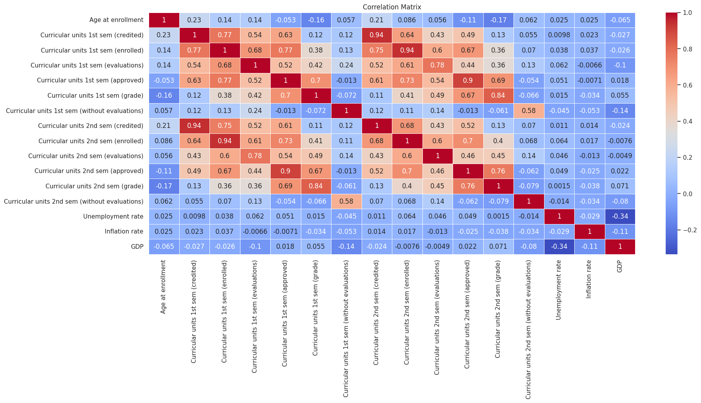

Slide 13
Correlation Matrix Analysis
Description:
This correlation matrix provides a comprehensive overview of the linear relationships between academic metrics and economic indicators.
It highlights strong correlations within and across semesters for various academic performance measures and the relatively weak influence of macroeconomic conditions on student grades.

Slide 14
Key Insights of Correlation Matrix
Strong Correlations:
Curricular Units (1st Sem): High correlations between credited, enrolled, evaluated, and approved units (e.g., credited vs. enrolled: 0.77).
Curricular Units (2nd Sem): Similar high correlations within the second semester variables (e.g., credited vs. enrolled: 0.94).
Across Semesters: Strong correlations between similar variables across semesters (e.g., 1st sem credited vs. 2nd sem credited: 0.94).
Analysis: The high correlations between credited, enrolled, evaluated, and approved units within both the first and second semesters (e.g., credited vs. enrolled: 0.77 for the first semester and 0.94 for the second semester) indicate that students who take on more courses are likely to complete them successfully. Additionally, the strong correlations across semesters (e.g., 1st semester credited vs. 2nd semester credited: 0.94) suggest consistency in academic performance over time. These findings highlight the importance of maintaining a balanced yet challenging course load and providing continuous support to sustain academic success.

Slide 15
2. Grades:
Moderate positive correlations between grades and approved units for both semesters.
1st Sem Grade vs. 2nd Sem Grade: Moderate positive correlation, indicating consistency in student performance across semesters.
Analysis: The moderate positive correlations between grades and approved units for both semesters suggest that students who achieve higher grades tend to complete and pass more courses. This indicates a direct relationship between academic performance and course completion rates. Additionally, the moderate positive correlation between first semester grades and second semester grades highlights the consistency in student performance over time. Students who perform well in one semester are likely to continue performing well in subsequent semesters, emphasizing the importance of maintaining academic support and interventions to ensure sustained success.

Slide 16
3. Economic Indicators:
Weak correlations between economic indicators (unemployment rate, inflation rate, GDP) and academic variables.
The strongest negative correlation is between GDP and unemployment rate (-0.34), as expected.
Analysis: The weak correlations between economic indicators (unemployment rate, inflation rate, GDP) and academic variables indicate that broader economic conditions have minimal direct impact on individual academic performance. This suggests that students' grades and course completions are largely independent of economic fluctuations. The strongest negative correlation is between GDP and the unemployment rate (-0.34), as expected. Educational institutions should prioritize direct academic support and resources to improve student performance, rather than focusing on external economic factors.

Slide 17
Selection of Proper Model for Academic Performance Prediction
Linear Regression: An MSE of 7.45 indicates some prediction errors, and an R² of 0.70 means the model explains 70% of the variance in the target variable, suggesting a relatively good fit.
Random Forest: With a much lower MSE of 1.19, it has significantly smaller prediction errors, and an R² of 0.95 indicates the model explains 95% of the variance, demonstrating a superior fit and higher accuracy compared to the linear regression model.

Slide 18
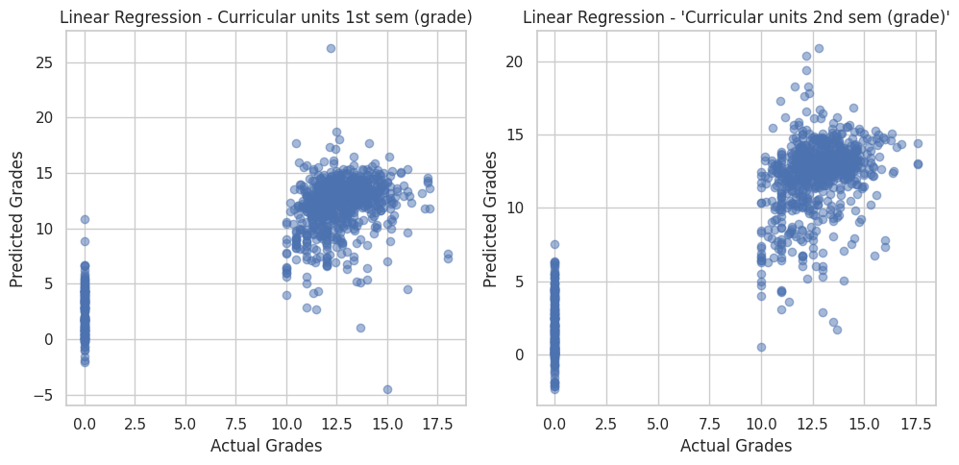

Slide 19
Analysis of Linear Regression Predictions
Left Plot: Linear Regression - Curricular Units 1st Sem (Grade)
Observation:
The scatter plot shows actual grades (x-axis) versus predicted grades (y-axis) for the first semester using a linear regression model.
There is a dense cluster of points around mid to high actual grades (10-15), suggesting reasonable accuracy in this range.
Significant prediction errors are evident for low actual grades, including unrealistic negative predictions.
The spread of points and outliers indicate variability and limitations in the model's accuracy, particularly for low grades.
Right Plot: Linear Regression - Curricular Units 2nd Sem (Grade)
Observation:
This scatter plot shows the actual grades versus predicted grades for the second semester using the same linear regression model.
Similar to the first semester, there is a dense cluster around mid to high grades (10-15), indicating reasonable prediction accuracy.
Fewer extreme outliers compared to the first semester, but notable errors persist.
The model shows slight improvement in prediction consistency for the second semester but still exhibits significant inaccuracies.
Overall Conclusion
Linear Regression Model Performance:
The model performs better for mid to high grades but has significant prediction errors for low grades.
Presence of outliers and variability in predictions indicates limitations in handling certain data ranges.
These results highlight the need for more robust modeling techniques to better capture data complexities and reduce prediction errors.

Slide 20
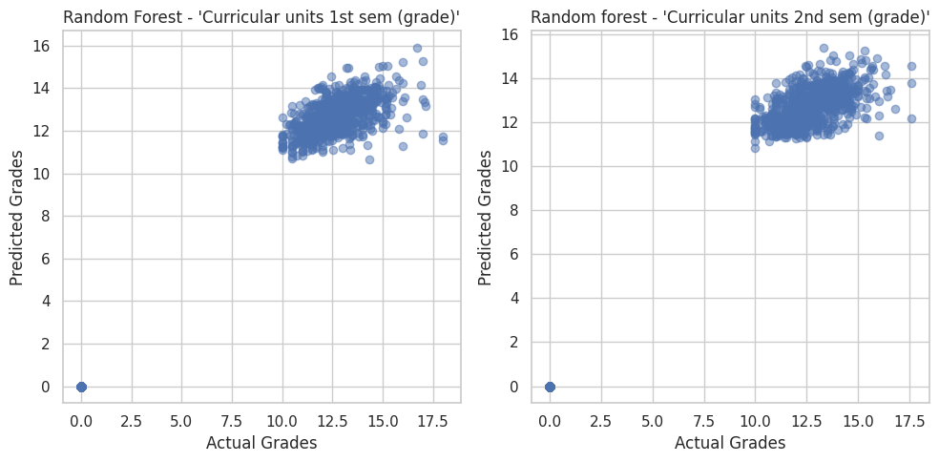

Slide 21
Analysis of Random Forest Predictions
Left Plot: Random Forest - Curricular Units 1st Sem (Grade)
Observation:
The scatter plot shows actual grades (x-axis) versus predicted grades (y-axis) for the first semester using a random forest model.
There is a dense cluster of points around the actual grades of 10-15, indicating high prediction accuracy in this range.
Very few outliers and prediction errors, with the model consistently predicting grades close to the actual values.
The random forest model shows minimal variability and high precision in its predictions for the first semester.
Right Plot: Random Forest - Curricular Units 2nd Sem (Grade)
Observation:
This scatter plot shows the actual grades versus predicted grades for the second semester using the random forest model.
Similar to the first semester, there is a dense cluster of points around actual grades of 10-15, indicating high prediction accuracy.
Very few outliers and high consistency in predictions, with the model maintaining high precision for the second semester as well.
The random forest model continues to show minimal variability and high accuracy in predicting grades.
Overall Conclusion
Random Forest Model Performance:
The model demonstrates high prediction accuracy and consistency for both semesters, particularly for mid to high grades.
Minimal prediction errors and outliers, indicating the model's robustness in handling the data.
The random forest model outperforms the linear regression model, providing more accurate and reliable predictions.

Slide 22
Recommendations
Adopt Advanced Models: Educational institutions should consider using advanced machine learning models like random forests for predicting student performance to leverage their superior accuracy and robustness.
Focus on Early Interventions: Early identification of at-risk students based on initial academic performance can help tailor interventions and support to improve their long-term success.
Continuous Monitoring: Regular monitoring of student performance and ongoing adjustments to support services can help maintain high academic standards and student outcomes.

Slide 23
Thank you

